Slide 1
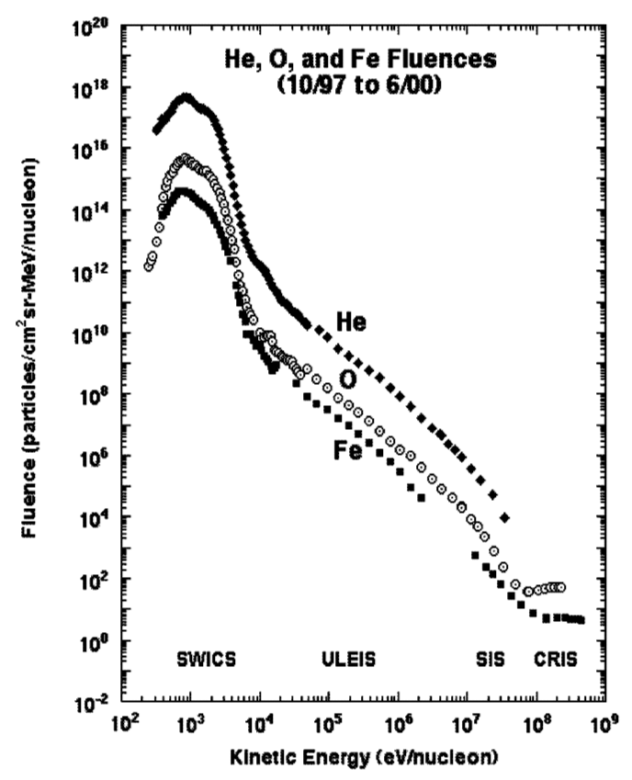
On the Acceleration of He Pickup Ions in the Inner Heliosphere
Mark Popecki, K. Simunac, A. Galvin, H. Kucharek
University of New Hampshire
Berndt Klecker
Max-Planck Institut fur extraterrestrische Physik
Interstellar neutral helium penetrates to well within 1 AU where it is ionized predominantly by UV from the Sun. These freshly created He+ pickup ions are convected outward with the solar wind and subject to acceleration processes, for example in compression regions, corotating interaction regions, or CME-driven interplanetary shocks. These acceleration processes result in the formation of suprathermal tails in the PUI velocity distribution. The PLASTIC instruments on the STEREO spacecraft cover for pickup He the energy range of ~1-20 keV/nuc, i.e. they allow the determination of PUI distribution functions from the source distribution to suprathermal energies. In this paper we study the suprathermal tails of He pickup ions during the time period January to December 2008 that featured many corotating interaction regions.
The PLASTIC observations for the He+ suprathermal tail show a large variability of the spectral index gamma of the distribution function f(w)~w^-gamma, with w = V/Vsw, where V and Vsw are the particle velocity and the solar wind velocity, respectively. Incorporating a transformation from the spacecraft frame to the solar wind frame, the spectral index at velocities 1.5 <= w <= 5 (in the solar wind frame) ranges from gamma ~ -5.1 at a forward shock to gamma = -9 in the slow solar wind.
4
6
Comparison of Phase Space Density Measurements
PLASTIC and ACE/SWICS He⁺ are compared for June 2007.
Phase space density for He⁺ is shown for both instruments.
Data are shown for the He⁺ spectral rolloff near 2*V_{sw}
PLASTIC data incorporate best values of:
  energy-dependent efficiency and
  geometric factor (GF)
Data are normalized near V/V_{sw} = 1
Normalization agrees to better than a factor of two with PLASTIC efficiencies and GF alone.
What do we see in a long term average for V/V_{sw} ≥ 3?
He+ Suprathermal Tail Jan-Oct 2008
Solar wind frame
The frame transformation from the spacecraft frame to the solar wind frame makes use of directional ion information.
No isotropy assumptions needed for the frame transformation.
All data for Jan-Oct 2008 included.
Livetime correction is included for days with V_{sw}/V_{swMax}
Spectral index in the V_{swframe} is:
  - 6.1 ± 0.9
1000000.00
100000.00
10000.00
Fit with index -6.1
PSD He+
1000.00
PSD (s³/km⁶)
100.00
10.00
1.00
PSD norm by livetime
0.10
Fit to PSD
0.01
0.0
Power ( Fit to PSD )
1.0
2.0
3.0
4.0
5.0
6.0
1
Vswframe/Vsw
He⁺ Tails from PLASTIC
Observations of H and He with SWICS instruments have indicated the presence of a V/V_{sw}⁻⁵ suprathermal tail (e.g. Gloeckler et al., 2007)
He+ suprathermal tails may be studied with STEREO/PLASTIC
PLASTIC is functionally similar to the SWICS instruments in:
  Measurement technique and
  Energy range
  but has a unique instrument design
PLASTIC observations are independent and complementary to those of SWICS
PLASTIC measures the arrival direction of ions. This enables a frame transformation from the spacecraft frame to the solar wind frame without an assumption of isotropy.
7
Spectral Index for Periods of Low Speed Solar Wind
V_{sw} ≤ 327 km/s
STEREO A, He⁺ 2008
The spectral index was calculated for:
  1.5 ≤ V_{swframe}/V_{sw} ≤ 5
Data are count limited at speeds beyond:
  V/V_{sw} = 3.7
  (~5 counts/speed bin)
Index with V_{swframe} is 7.9 ± 0.7, still steeper than -5.
100000
10000
1000
Fit with
PSD He+
100
index
-7.9
10
B. Klecker, Eberhard Moebius
PSD (s³/km⁶)
2
1
PLASTIC Spatial Viewing
STEREO PLASTIC has three apertures.
The solar wind aperture uses deflectors, azimuth, time-of-flight and energy measurements to obtain M, Q, E and incoming direction of solar wind ions.
Apertures for directions other than the solar wind provide M, Q, E or just M/q.
PLASTIC is primarily a solar wind instrument, but it can provide some suprathermal tail data as well.
Ion Selection: Energy/q
Measurements:
  Time of Flight,
  Residual Energy (SSD)
5
0.1
Observation period
305 days from Jan to Oct 2008
A long term average of He⁺ phase space density was calculated from ~10 months of 2008 on STEREO A
Several CIRs occurred
S/W speeds were between 300 and 775 km/s
68% of the 305 days have a daily average SW speed ≤ 500 km/s and can be entirely measured in the energy range of the entrance system up to V/V_{sw} ≤ 4.
0.01
0
1
2
3
4
5
6
Solar Wind
• E/q
• TOF
• Essd
Vswframe/Vsw
deflectors
Suprathermal ions
• E/q
• TOF
• Essd
8
10000.00
Low Speed Solar Wind Example: 2008, DOY 300
A low speed solar wind day is shown.
The index is -7.7 ± 0.7
Fit range:
  1.5 ≤ V_{swframe}/V_{sw} ≤ 3.3
1000.00
Fit with index
• E/q
• TOF
100.00
-7.7
Suprathermal ions
PSD (s³/km⁶)
PSD (s^3/km^6)
10.00
STA Speed (km/s)
1.00
3
0.10
Ion Fluence from solar wind to cosmic rays in solar minimum
He, O and Fe fluences during an active solar period are shown (Mewaldt et al., 2001).
The energy spectrum changes at ~7 keV/nuc from one that is characteristic of solar wind to another that is characteristic of energetic particles.
He+ can be measured by PLASTIC at energies up to ~20 keV/nuc
0.01
0
1
2
3
4
5
6
Summary:
STEREO/PLASTIC observations of the He⁺ suprathermal tail
A solar wind frame transformation has been developed and applied to He⁺ suprathermal tail data, using directional information from PLASTIC.
The Jan-Oct 2008 Period
  The He+ spectral index in the S/W frame is -6.1 ± 0.9 for
  1.5 ≤ V/V_{sw} ≤ 5 (s/w frame speed range)
Low speed solar wind: Vsw ≤ 327 km/s
  The He+ spectral index in the S/W frame is -7.5 ± 0.7 for
  1.5 ≤ V/V_{sw} ≤ 4.4 (s/w frame speed range)
Additional low speed periods are under investigation
Vswframe/Vsw
9
Fe
Days with a solar wind speed Vsw ≤ 327 km/s are identified with green “+” symbols.
Many are immediately following CIR passages.
Are tails in low speed periods affected by local acceleration in CIRs?
O
He+
Mewaldt et al. 2001
Low speed days
DOY 300; see above

